Slide 1
FancyKids app design
Irina Poliantseva

Slide 2
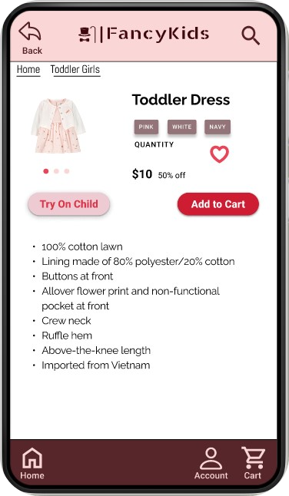
Project overview
The product:
FancyKids app is a clothing store that offers affordable pricing options. The typical user is a parent with kids under 12 years old. The best part? In addition to buying clothes for their kids, parents can also sell their children's outgrown clothing on the app. FancyKids app is designed to make the life of parents easier by offering a one-stop-shop for all their kids' clothing needs.
Preview of selected polished designs.
Project duration:
November 2023 - December 2023

Slide 3
Project overview
The problem:
Available online children’s stores don’t offer affordable prices and an option to sell the children’s outgrown clothing.
The goal:
Design the FancyKids app to be user friendly by providing clear navigation and offering new options like the Try On feature.

Slide 4
Project overview
My role:
UX Designer leading the FancyKids app design
Responsibilities:
Conducting interviews, paper and digital wireframing, low and high-fidelity prototyping, conducting usability studies, accounting for accessibility, iterating on designs.

Slide 5
User research
Personas
Problem statements
User journey maps
Understanding
the user

Slide 6
User research: summary
I conducted five online interviews with moms, who would be interested in my app. Since I’m a mother myself, my assumptions were pretty close to interview’s answers. I discovered that many target users treat online shopping as a fun and relaxing activity when they need a break from household or work. However, many shopping websites don’t offer the options that parents desire, such as the ability to sell outgrown clothing or the Try On Child feature. This feature would allow parents to try clothes on their children virtually, ensuring a proper fit and reducing the need for returns. By offering featured as these, the FancyKids app can improve the overall customer experience and build customer loyalty.

Slide 7
User research: pain points
1
2
3
4
Time wasting
A lot of outgrown kids clothes
No stores near them accepting used clothes
Limited budget
Wasted time for shopping in stores while online shopping saves time
Looks for cheaper kids clothing
Frustrated about tons of outgrown kids clothing
After checking they couldn’t find any store nearby that would accept their kids clothes in good condition

Slide 8
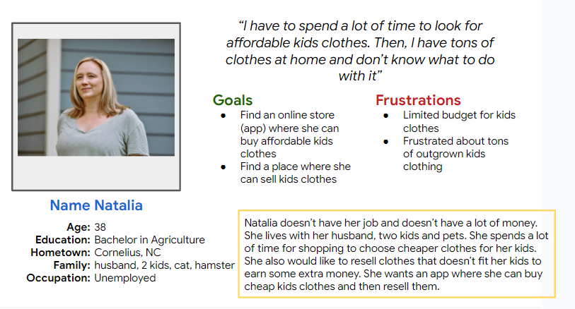
Persona: Natalia
Problem statement:
Natalia is a 38 years old mother who needs online store where she can buy and sell kids clothing..

Slide 9
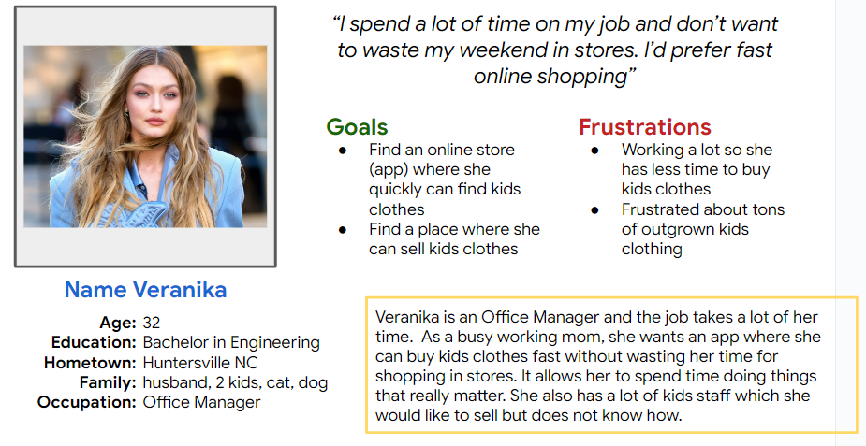
Persona: Angie
Problem statement:
Angie is a busy working mom of two kids, who needs an app to buy kids clothing fast online, because shopping in stores takes too much time and isn’t a good use of Angie’s time.

Slide 10
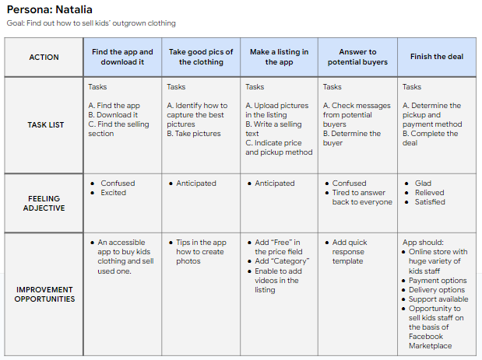
User journey map
Natalia has two goals: find an app where she can buy affordable kids clothing and sell her kids’ outgrown clothing.
Image of user journey map

Slide 11
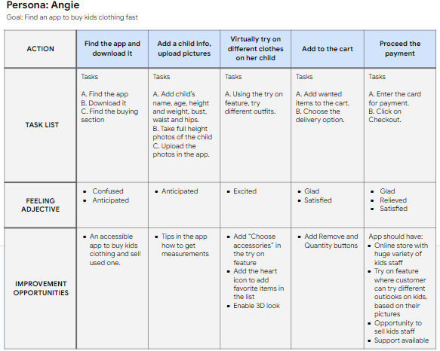
User journey map
Angie has two goals: find an app where she can buy kids clothing fast and sell her kids’ outgrown clothing.

Slide 12
Paper wireframes
Digital wireframes
Low-fidelity prototype
Usability studies
Starting
the design

Slide 13
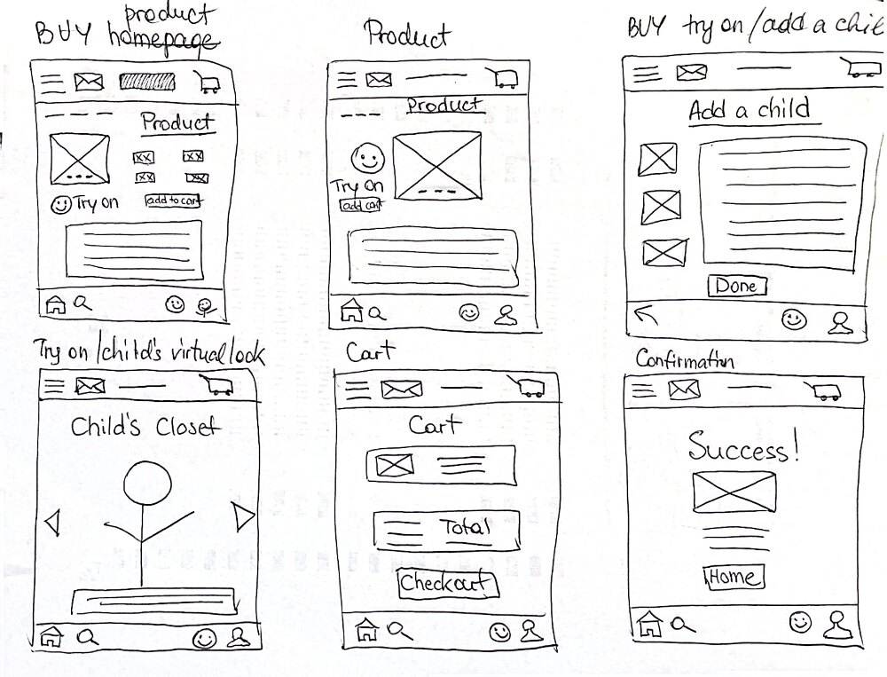
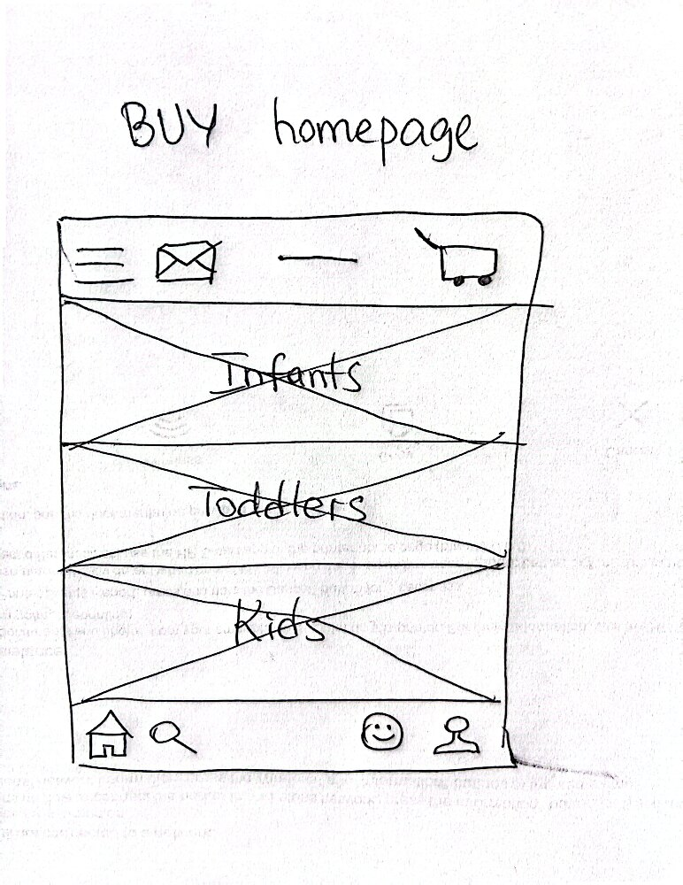
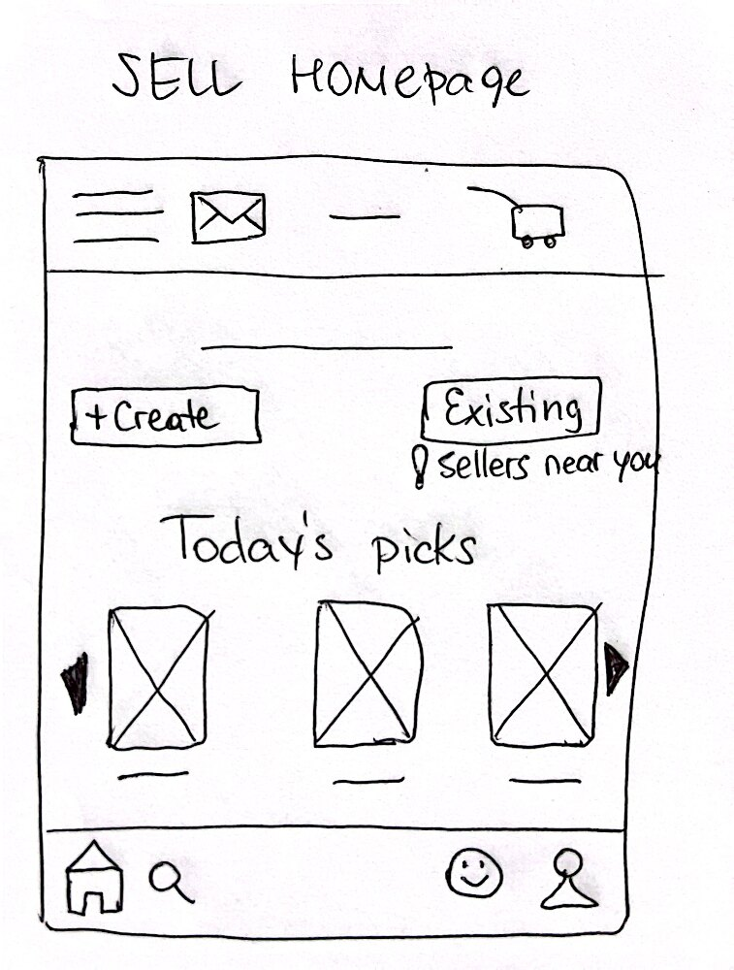
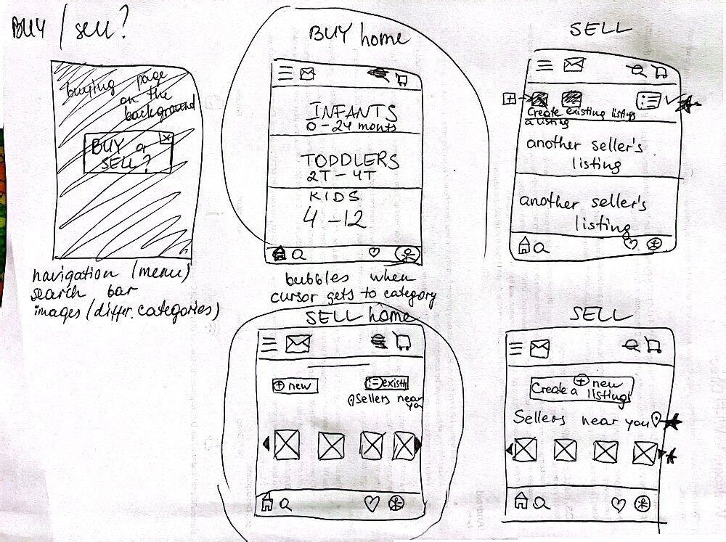
Paper wireframes
The app has two sections, BUY and SELL to satisfy user needs. Both sections have the homepages.
Image of paper wireframes including five different versions of the same screen and one image of the new, refined version

Slide 14
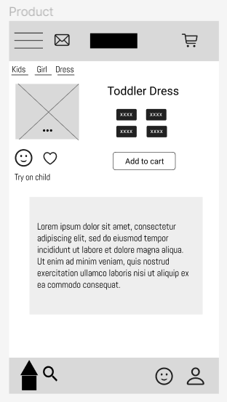
Digital wireframes
This is the example of the product page from the buying section. In addition to the usual elements, it has try on feature that allows try different outlooks on the customer’s child, based on their measurements and pictures.
Try on feature includes 3D visualization
Insert first wireframe example that demonstrates design thinking aligned with user research
Choose color, size and quantity

Slide 15
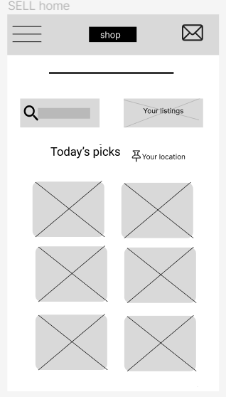
Digital wireframes
This is the example of the home page from the selling section. It allows users to access their existing listings and see other users’ listings.
Insert second wireframe example that demonstrates design thinking aligned with user research
User will see soap bubbler, when the cursor approaches to buttons
Listings of other sellers

Slide 16
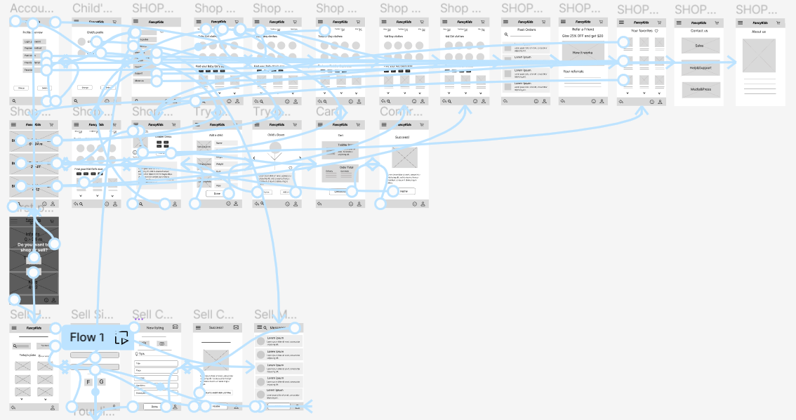
Low-fidelity prototype
The black screen is the very first page the user will see after opening the website. It has introduction and two main sections: SHOP and SELL.
Other screens complete the main user flow.
View FancyKids low-fidelity prototype
Screenshot of prototype with connections or prototype GIF

Slide 17
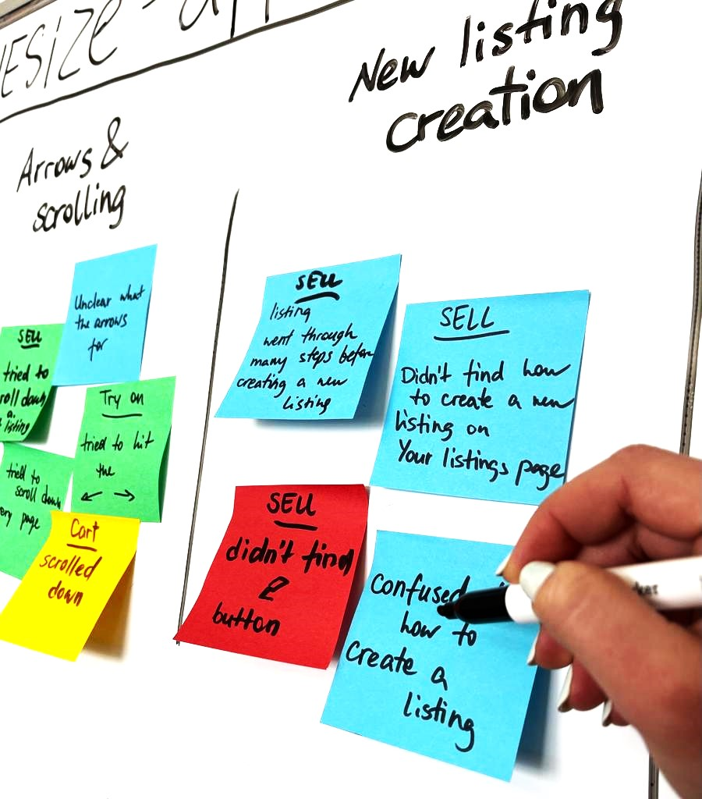
Usability study: findings
Round 1 findings
Round 2 findings
1
Users want more customization options
1
The App’s Logo is not as easily recognized as a button.
2
Users want a more intuitive way to access the new listing creation.
2
Minor changes of Menu options are required
3
Users want to change some button’s names and icons

Slide 18
Refining
the design
Mockups
High-fidelity prototype
Accessibility

Slide 19
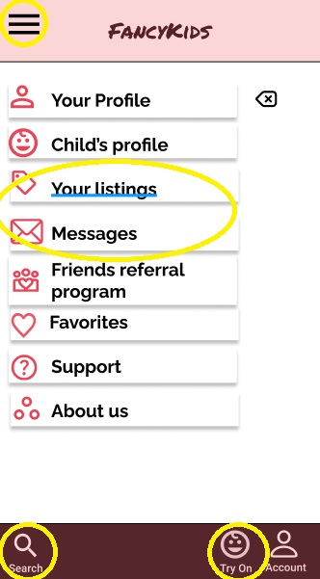
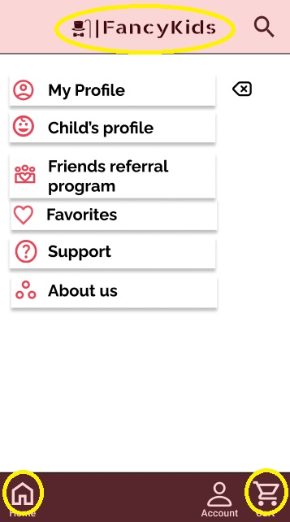
Mockups
Menu screen
Before usability study
After usability study
I changed the navigation and menu options, as well as the app’s logo. The study participants didn’t understand that the logo can be a homepage button. I added the separate homepage button, removed the hamburger menu and the Try On Child feature from the bottom.
Image of selected screen before usability study
Image of selected screen after usability study

Slide 20
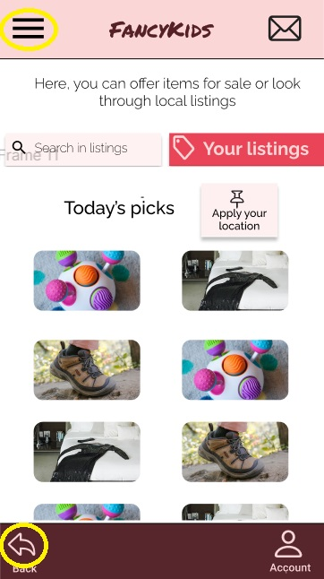
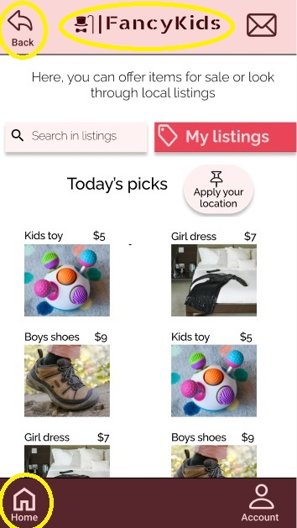
Mockups
SELL section
Before usability study
After usability study
The above changes affected all screens. The arrow back was moved to top of the screen and the homepage button is at bottom now. I changed the logo and the “Apply your location” button.
Image of selected screen before usability study
Image of selected screen after usability study

Slide 21
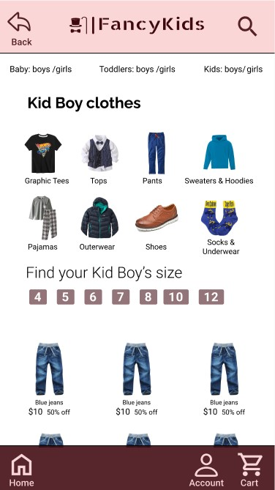
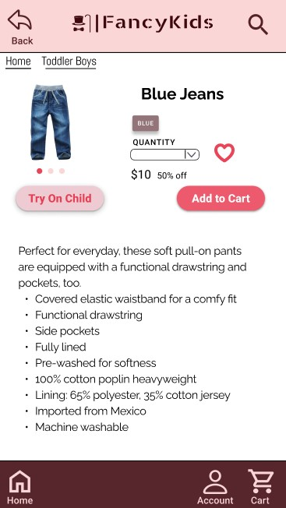
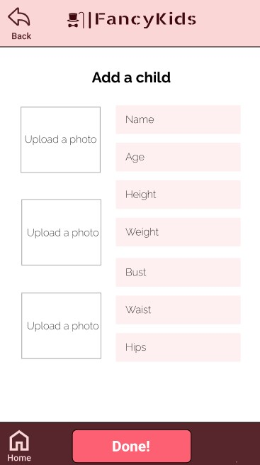
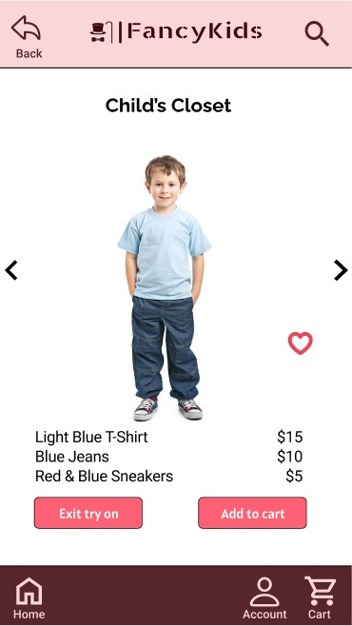
Mockups: main user flow (shop)
Main mockup screen for display
Main mockup screen for display
Main mockup screen for display
Main mockup screen for display

Slide 22
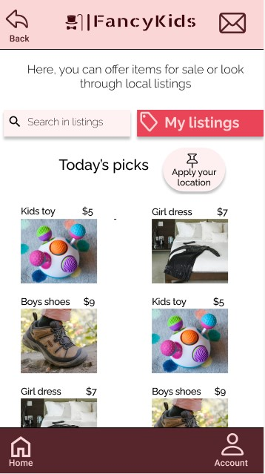
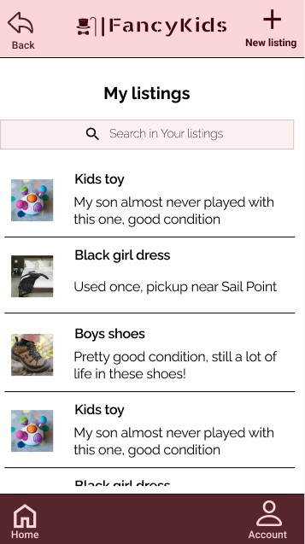
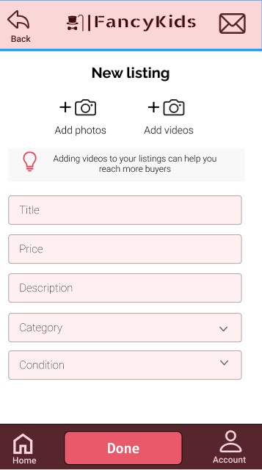
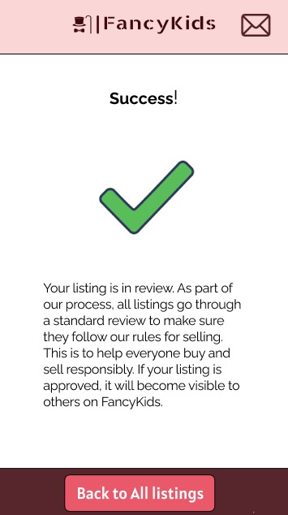
Mockups: main user flow (sell)
Main mockup screen for display
Main mockup screen for display
Main mockup screen for display
Main mockup screen for display

Slide 23
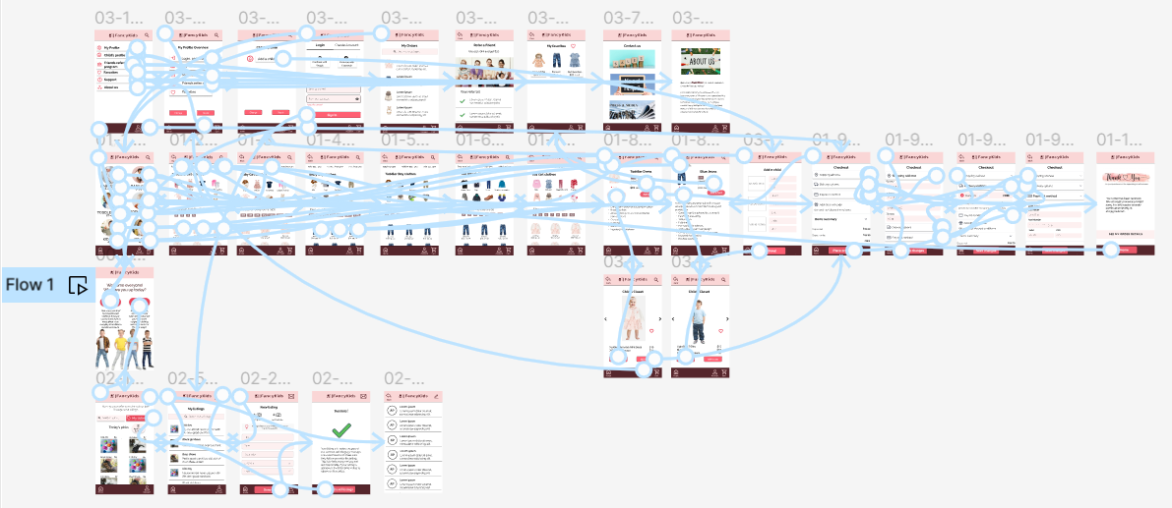
High-fidelity prototype
View FancyKids high-fidelity prototype
Screenshot of prototype with connections or prototype GIF

Slide 24
Accessibility considerations
1
2
3
Colors
The FancyKids app has color combinations with a contrast ratio of 12.49:1 (HEX #FAD6D6 and HEX #3F080E) and contrast ratio 4.88:1 for buttons
(HEX #DD1D33 and HEX #FFFFFF) according to WCAG (Web Content Accessibility Guidelines)
Gestures and Motion
The gestures in the FancyKids app provide alternative ways of interacting that are more intuitive and expressive. It helps in better accessibility for individuals with reduced reading ability.
Consistency
Consistent design themes, including heading styles,font choices, icons, buttons and layouts help users predict where page elements can be found and in helping them navigate. Users with cognitive impairments may be unable to recognize items if they are not consistent in appearance.

Slide 25
Going forward
Takeaways
Next steps

Slide 26
Takeaways
Impact:
Our target users shared that the design was intuitive to navigate through, more engaging with the images, and demonstrated a clear visual hierarchy.
What I learned:
I learned that even a small design change can have a huge impact on the user experience. The most important takeaway for me is to always focus on the real needs of the user when coming up with design ideas and solutions.

Slide 27
Next steps
1
2
Conduct follow-up usability testing on the new website
Identify any additional areas of need and ideate on new features

Slide 28
Insert a few sentences summarizing the next steps you would take with this project and why. Feel free to organize next steps in a bullet point list.
Let’s connect!
Thank you for reviewing my work on the FancyKids app!
If you’d like to see more, or would like to get in touch, my contact information is provided below:
Email: poliantseva.irina@gmail.com
LinkedIn: https://www.linkedin.com/in/irina-poliantseva/

